Slide 1
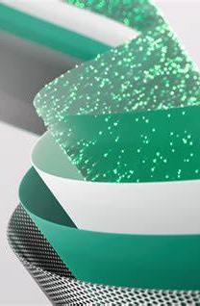
Microsoft Fabric: Data Mesh Architecture
Marc Bushong
Sr Cloud Solution Architect @Microsoft
www.linkedin.com/in/marcbushong
Presentation available on LinkedIn or:
https://github.com/mbushong16/SQLSaturday

Slide 4


Get your SQL Questions answered here by our SQL Experts
(Across from Registration)

Slide 5

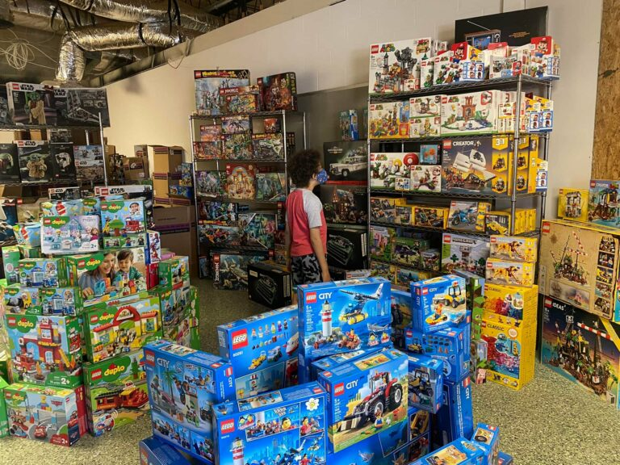
501 Legion Charitable Donation & LEGO Drive
Thank the 501 Legion for Supporting Our Event!
JSSUG Will Match Donations up to $1000
Donation Bucket on Registration Table
LEGO donation on V for Victory Table

Slide 6
Costume Contest Rules
1. Take a picture with the SQL Saturday Backdrop during the event
2. Post the picture to Twitter/X and include the hashtag #SQLSatJax24CC
3. The tweet using the hashtag that has the most "likes" wins a prize!

Slide 7
Session Evaluations
Your feedback is important to us!
Please fill out and hand to speaker after the session!

Slide 8
Event Evaluation
Fill out event evaluation card in your bag and visit all sponsors to be entered to win an Xbox Series X – (Must be present to win)

Slide 9
Agenda
Data Mesh Crash Course
Microsoft Fabric Relevant Components Overview
Data Mesh in Fabric
Architecture Patterns
Q/A

Slide 10
What does Data Mesh even mean?
Data mesh is an architectural pattern for implementing enterprise data platforms in large and complex organizations.
Data mesh helps scale analytics adoption beyond a single platform and a single implementation team.
Apart of Well-Architected Framework (WAF)
Why Data Mesh?
Think single team owning all analytics data/operations and the potential issues

Slide 11
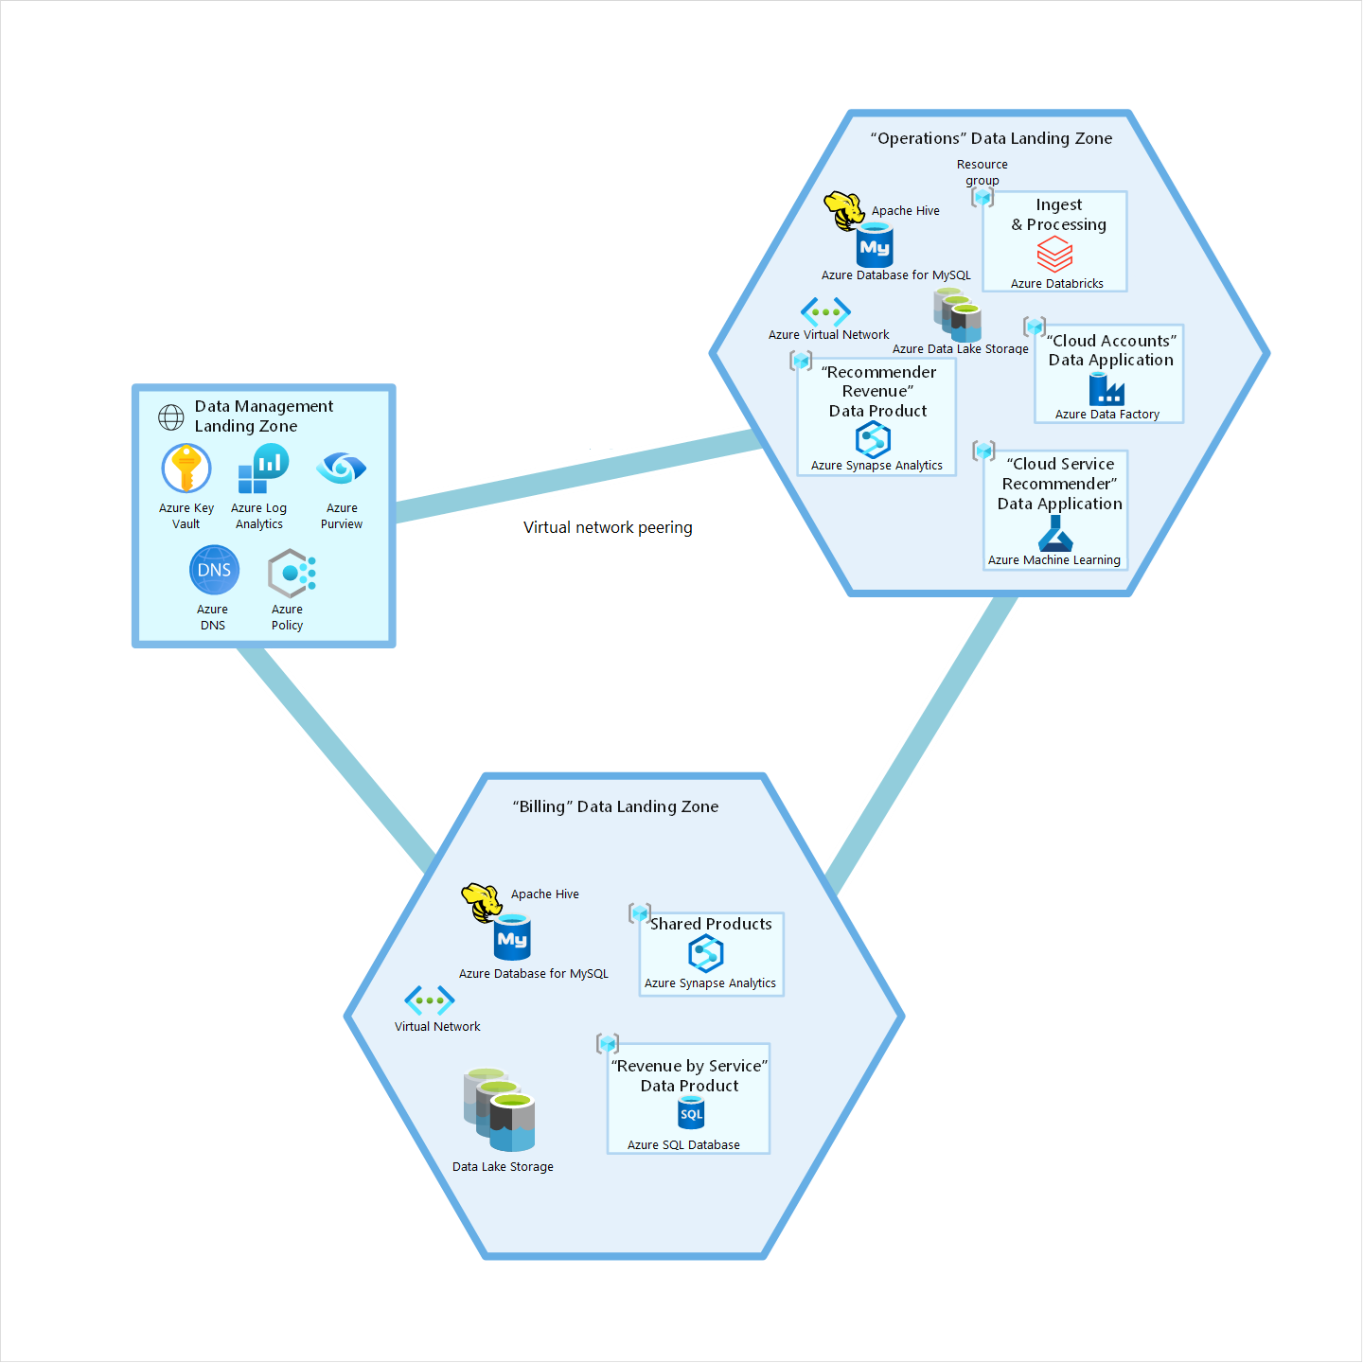
Example of Landing Zones/Simple Mesh

Slide 12
Foundational Concepts for Data Mesh Architecture
Data Domains
Data Products
Self-serve Platforms
Federated Governance

Slide 13
Data Domains
Foundation of Data Mesh
Decentralization and the distribution of responsibility to domains
Defines boundaries around your data/functionality
Long term ownership.
Match reality and not just theoretical concepts.
Atomic integrity.

Slide 14
Data Domains
Think but don’t overthink it…
You probably already have domains but you just don’t call them that or haven’t noticed.
Every organization is different.
If you are having trouble, think more abstract
Many types of domains
Application domains, data domains, source system domains, consumer domains, etc.

Slide 15
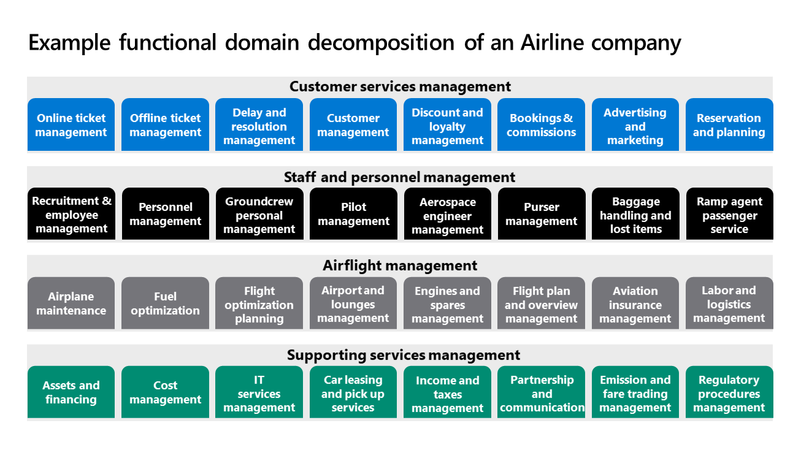

Slide 16
Data Products
Data is the product…
Application owners/teams treat data as fully contained product
Data Products in Data Mesh prevents some common integration issues
Think if some underlying data in a report changes, it changes the way the business might make decisions off it.
Knowledge gaps, ownership issues, the “That is not my department” issue…
Which still may be valid depending
Data products are created specifically for analytical consumption

Slide 17
Well Designed Data Products
Discoverable, understandable, and trustworthy
Addressable, natively accessible, and secure
Interoperable, truthful, and valuable

Slide 18
Data Products Design Recommendations
Might need to acquire new set of skills or new tools and platforms.
Focus on the data as a product’s needs
Services may differ from other domains
Or they can be shared!

Slide 19
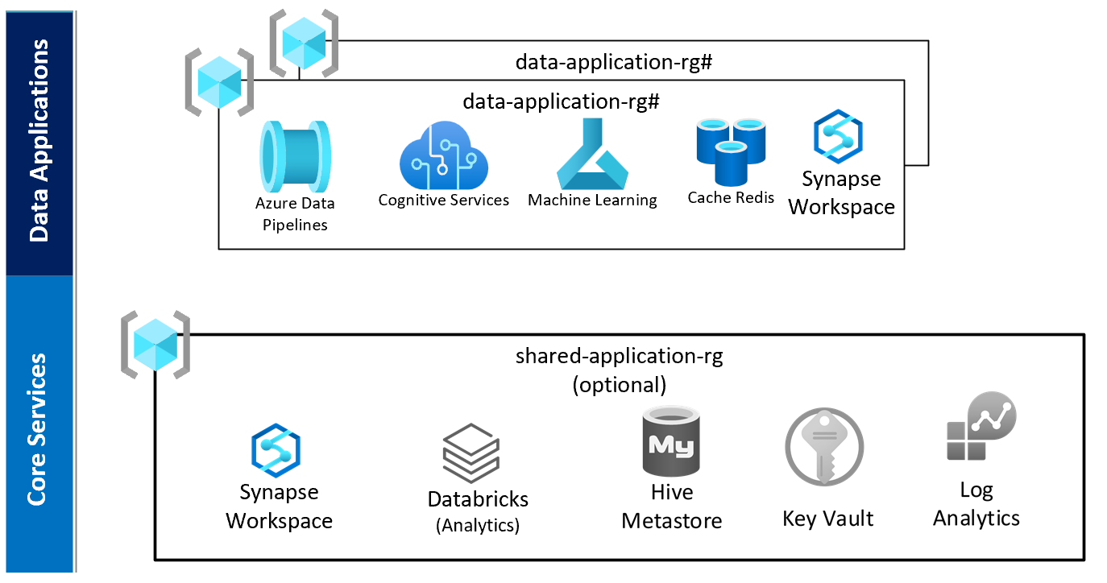

Slide 20
Self-Serve Platforms
Fancy for letting domains/teams/users operate independently
No strong dependency on central platform or team.
Central team can still exist in a capacity, but they are not causing impediments to self serving.

Slide 21

Federated Governance
Lack of governance leads to bad things
Silos and data duplication to name some
Federate the governance to the domain owners/admins
Align governance experts with the data owners/domains
Governance is a larger topic and won’t dive too deep for this.

Slide 22
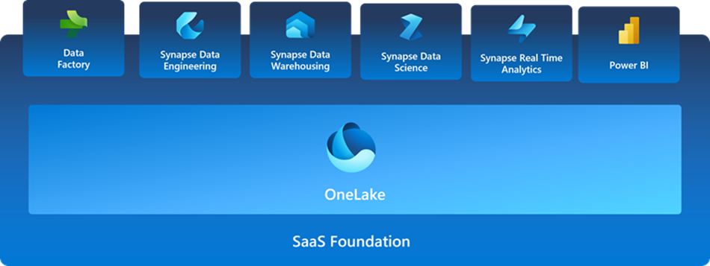
What is Microsoft Fabric?

Slide 23

Key Components in Fabric for Data Mesh
All Fabric Components
Reason is the mix and match for the data products
Microsoft Purview
Integrated with Fabric and planning to expand functionality
Governance
One Lake Data Hub to discover/browse
Especially Shortcuts and Mirrored DBs
Domains

Slide 24
Shortcuts and Mirroring
Shortcuts
Shortcuts are objects in OneLake that point to other storage locations.
The location can be internal or external to OneLake.
AWS S3, OneLake, ADLS Gen2, Dataverse, GCP S3
Database Mirroring
Not ETL process to replicate near-real time your DB.
Compute to mirror is FREE
Storage is FREE up to the SKU level in TBs
F2 SKU = 2 TB FREE
Snowflake, Azure Cosmos DB, Azure SQL DB, more likely planned.
Symbolic Link

Slide 25

Fabric Administration Components
Tenant
Capacities
Workspaces
Artifacts
All components. Including features like Shortcuts & Mirroring
Compute. Can be assigned to one or many workspaces.
Space for boundaries and collaboration.
Contains all your artifacts

Slide 26
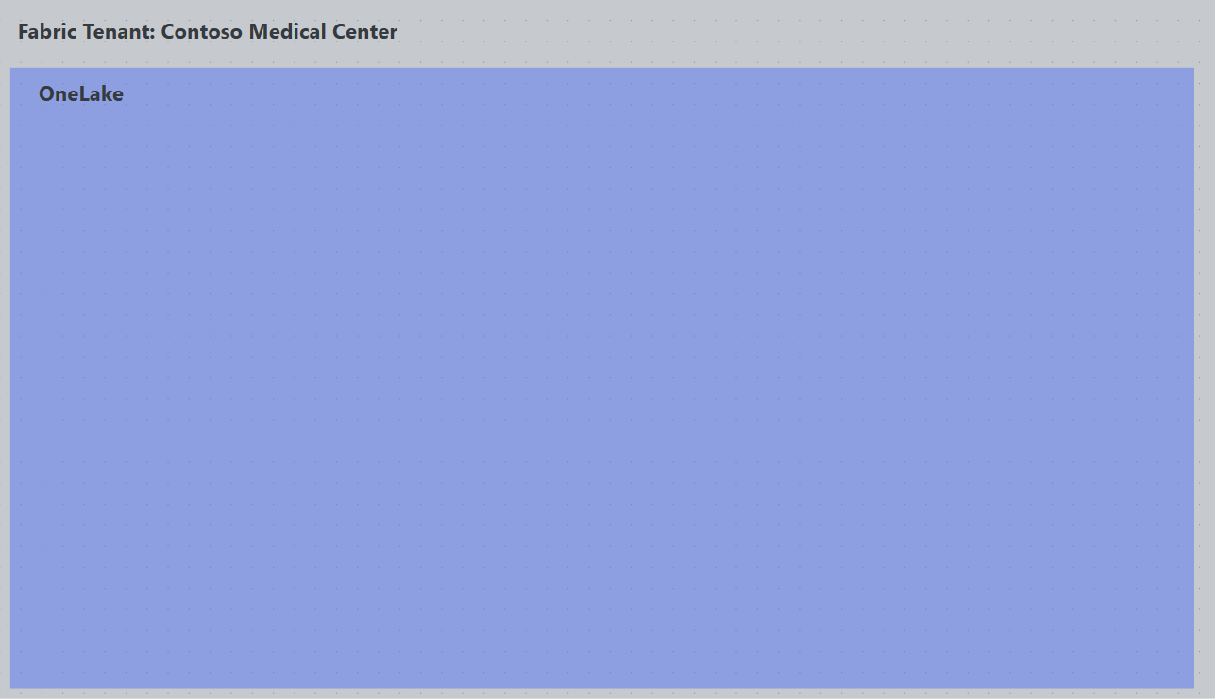

Slide 27
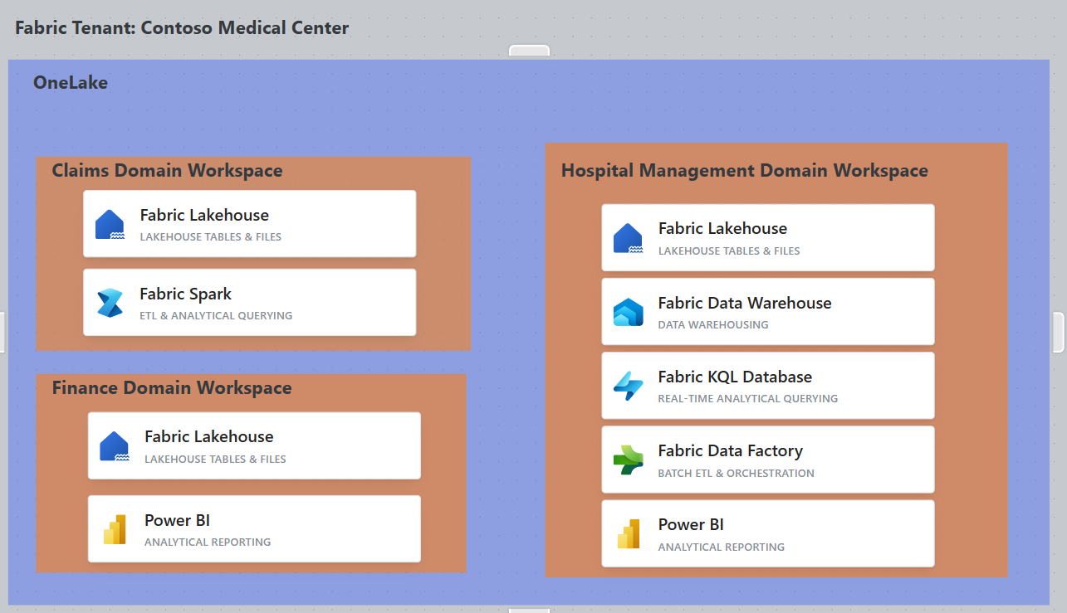

Slide 28
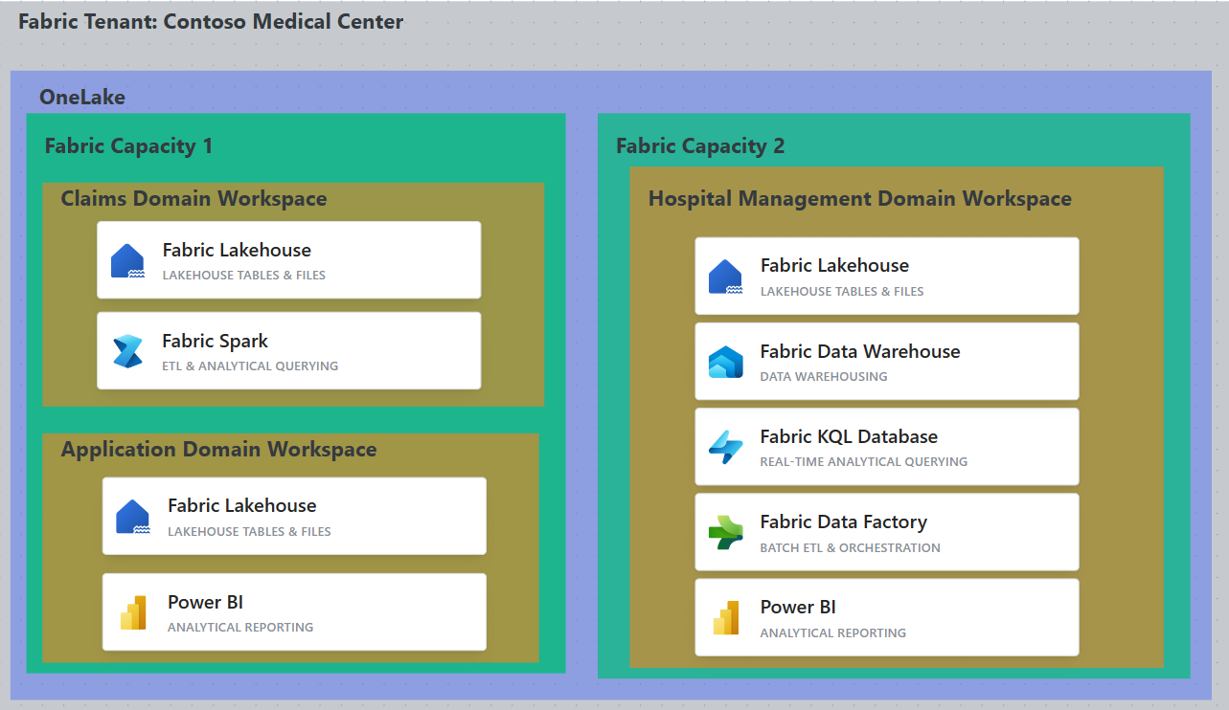

Slide 29

Data Mesh in Fabric
All components of Data Mesh Architecture Exist
Domains
Delegating selected tenant settings to control at the domain-level
Subdomains
Data Products
No more need for multiple services in the product. Can build on existing products as well.
Self-Serve Platforms
Federated Governance
Purview contains Data Products in Data Management.
GA Expected Q4
Needs additional configuration for integration not in scope here
Domain Admins, Capacity Admins, Workspace Roles, Artifact Permissions

Slide 30
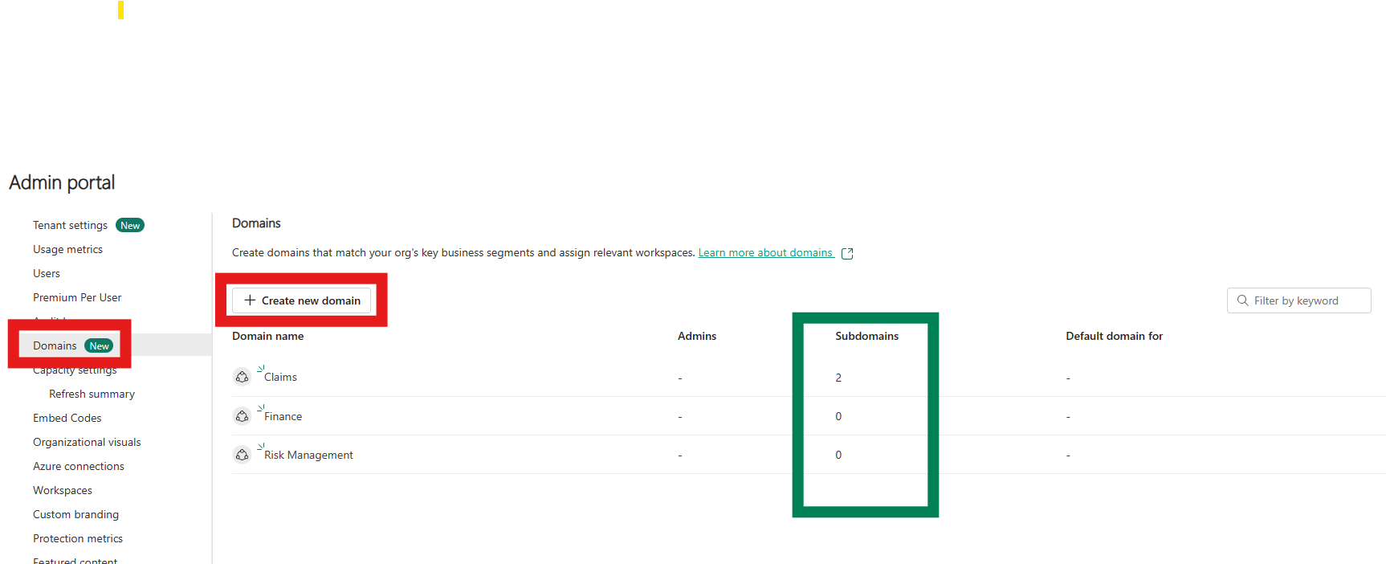

Slide 31
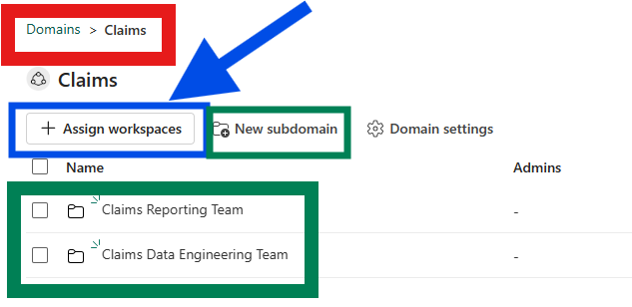

Slide 32
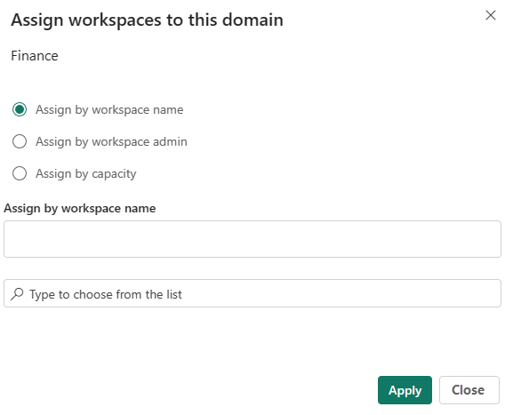

Slide 33
Architecture Patterns
Medallion Architecture Review if needed
Different Architectures of Data Mesh

Slide 34
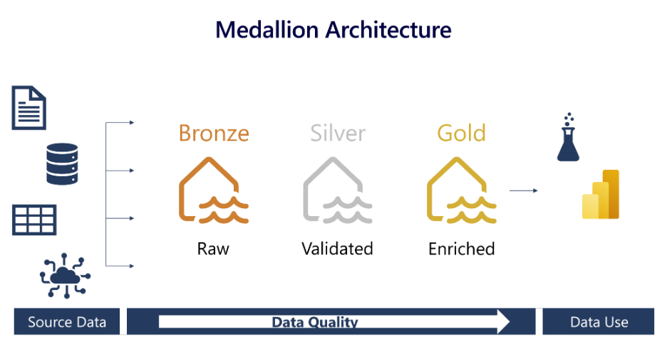
General Medallion Architecture

Slide 35
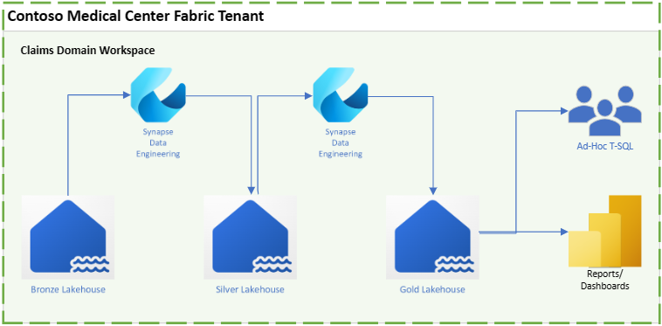

Slide 36
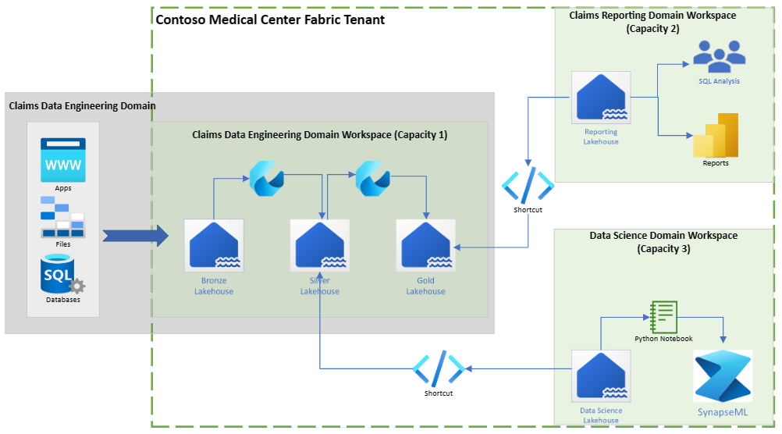

Slide 37
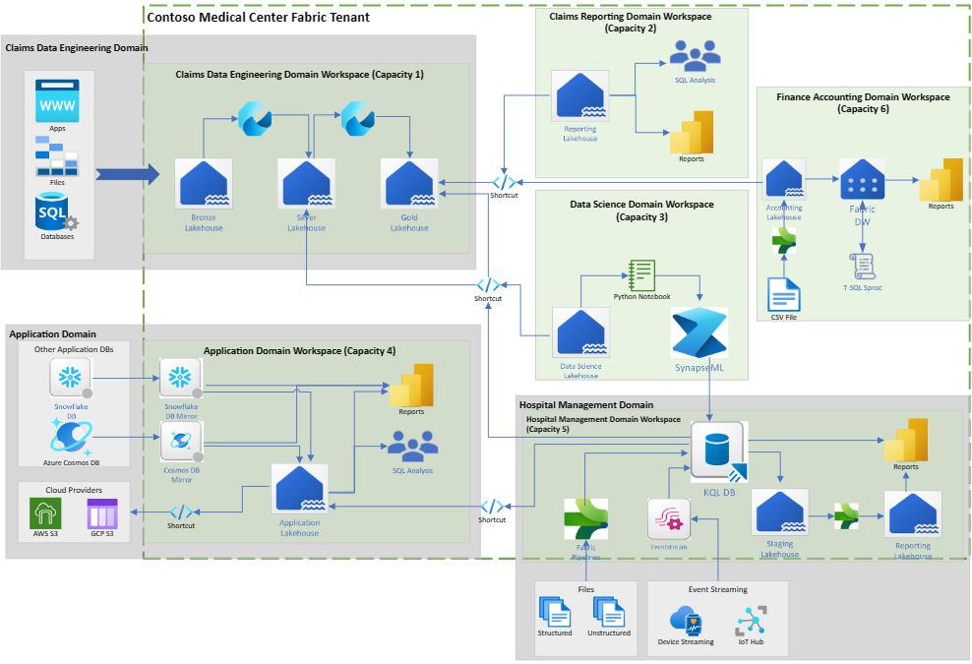

Slide 38

Helpful Tips for Moving Forward
This is just the beginning of the journey.
Master Data Management
Data Governance Strategies
Many more not covered here
Must have a well-defined strategy for implementation
Iron out use cases, scaling strategy, and objectives
Good idea to have dedicated team or program board to oversee the process
Start small and simple
Clear concise use case and skills already in house

Slide 39

Questions?

